Slide 1
Decision Making in C
Decision making structures require that the programmer specify one or more conditions to be evaluated or tested by the program.
Statement or statements to be executed if the condition is determined to be true, and optionally, other statements to be executed if the condition is determined to be false.

Slide 2
if statement
if statement consists of a boolean expression followed by one or more statements.
Syntax
if(boolean_expression)
{
/* statement(s) will execute if the boolean expression is true */
}

Slide 3
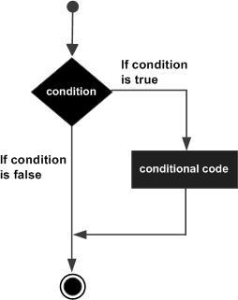
The boolean expression evaluates to true, then the block of code inside the if statement will be executed.
If boolean expression evaluates to false, then the first set of code after the end of the if statement (after the closing curly brace) will be executed.

Slide 4
Program
#include <stdio.h>
int main ()
{
/* local variable definition */
int a = 10;
/* check the boolean condition using if statement */
if( a < 20 )
{
/* if condition is true then print the following */
printf("a is less than 20\n" );
}
printf("value of a is : %d\n", a);
return 0;
}

Slide 5
if...else statement
An if statement can be followed by an optional else statement, which executes when the boolean expression is false.
Syntax
if(boolean_expression)
{
/* statement(s) will execute if the boolean expression is true */
}
else
{
/* statement(s) will execute if the boolean expression is false */
}
If the boolean expression evaluates to true, then the if block of code will be executed, otherwise else block of code will be executed.

Slide 6
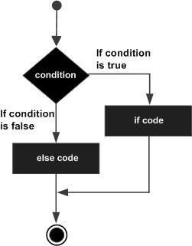
Any non-zero and non-null values as true and if it is either zero or null then it is assumed as false value.

Slide 7
Program
#include <stdio.h>
int main ()
{
/* local variable definition */
int a = 100;
/* check the boolean condition */
if( a < 20 )
{
/* if condition is true then print the following */
printf("a is less than 20\n" );
}
else
{
/* if condition is false then print the following */
printf("a is not less than 20\n" );
}
printf("value of a is : %d\n", a);
return 0;
}

Slide 8
The if...else if...else Statement
An if statement can be followed by an optional else if...else statement, which is very useful to test various conditions using single if...else if statement.
An if can have zero to many else if's and they must come before the else.
Once an else if succeeds, none of the remaining else if's or else's will be tested.

Slide 9
Syntax
if(boolean_expression 1)
{
/* Executes when the boolean expression 1 is true */
}
else if( boolean_expression 2)
{
/* Executes when the boolean expression 2 is true */
}
else if( boolean_expression 3)
{
/* Executes when the boolean expression 3 is true */
}
else
{
/* executes when the none of the above condition is true */
}

Slide 10
Program
#include <stdio.h>
int main ()
{
/* local variable definition */
int a = 100;
/* check the boolean condition */
if( a == 10 )
{
/* if condition is true then print the following */
printf("Value of a is 10\n" );
}
else if( a == 20 )
{
/* if else if condition is true */
printf("Value of a is 20\n" );

Slide 11
}
else if( a == 30 )
{
/* if else if condition is true */
printf("Value of a is 30\n" );
}
else
{
/* if none of the conditions is true */
printf("None of the values is matching\n" );
}
printf("Exact value of a is: %d\n", a );
return 0;
}

Slide 12
Nested if statements
It Means you can use one if or else if statement inside another if or else if statement(s).
Syntax
if( boolean_expression 1)
{
/* Executes when the boolean expression 1 is true */
if(boolean_expression 2)
{
/* Executes when the boolean expression 2 is true */
}
}

Slide 13
Program
#include <stdio.h>
int main ()
{
/* local variable definition */
int a = 100;
int b = 200;
/* check the boolean condition */
if( a == 100 )
{
/* if condition is true then check the following */
if( b == 200 )
{
/* if condition is true then print the following */
printf("Value of a is 100 and b is 200\n" );
}
}
printf("Exact value of a is : %d\n", a );
printf("Exact value of b is : %d\n", b );
return 0;
}

Slide 14
switch statement
A switch statement allows a variable to be tested for equality against a list of values.
Each value is called a case, and the variable being switched on is checked for each switch case.
A switch statement can have an optional default case, which must appear at the end of the switch.
The default case can be used for performing a task when none of the cases is true.
No break is needed in the default case.

Slide 15
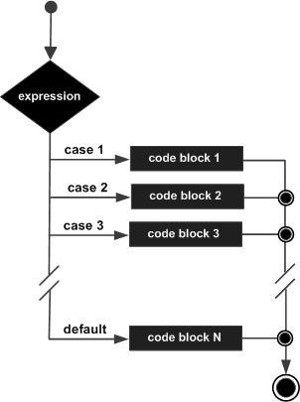
Flow Diagram

Slide 16
Program
#include <stdio.h>
int main ()
{
/* local variable definition */
char grade = 'B';
switch(grade)
{
case 'A' :
printf("Excellent!\n" );
break;
case 'B' :
case 'C' :
printf("Well done\n" );
break;

Slide 17
case 'D' :
printf("You passed\n" );
break;
case 'F' :
printf("Better try again\n" );
break;
default :
printf("Invalid grade\n" );
}
printf("Your grade is %c\n", grade );
return 0;
}

Slide 18
Nested switch statements
It is possible to have a switch as part of the statement sequence of an outer switch.
Syntax
switch(ch1) {
case 'A':
printf("This A is part of outer switch" );
switch(ch2) {
case 'A':
printf("This A is part of inner switch" );
break;
case 'B': /* case code */
}
break;
case 'B': /* case code */
}

Slide 19
Program
#include <stdio.h>
int main ()
{
/* local variable definition */
int a = 100;
int b = 200;
switch(a) {
case 100:
printf("This is part of outer switch\n", a );
switch(b) {
case 200:
printf("This is part of inner switch\n", a );
}
}
printf("Exact value of a is : %d\n", a );
printf("Exact value of b is : %d\n", b );
return 0;
}

